Slide 1

Computer Vision
Naeemullah Khan
naeemullah.khan@kaust.edu.sa
KAUST Academy
King Abdullah University of Science and Technology
January 07, 2024
Computer Vision

Slide 2
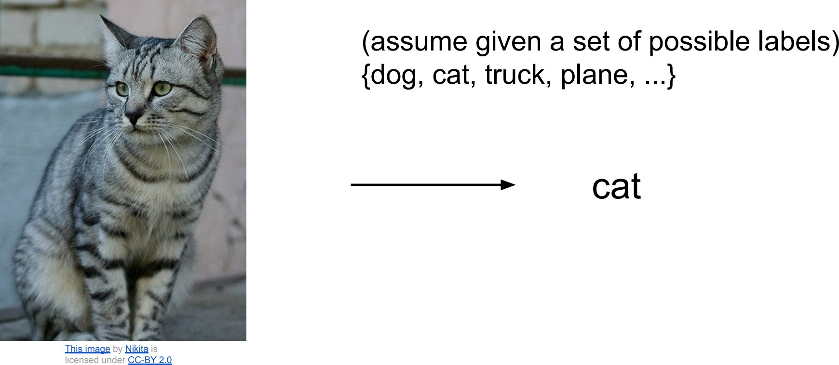
Image Classification
▶ Previously, we discussed Image Classification
▶ A core task in Computer Vision

Slide 3
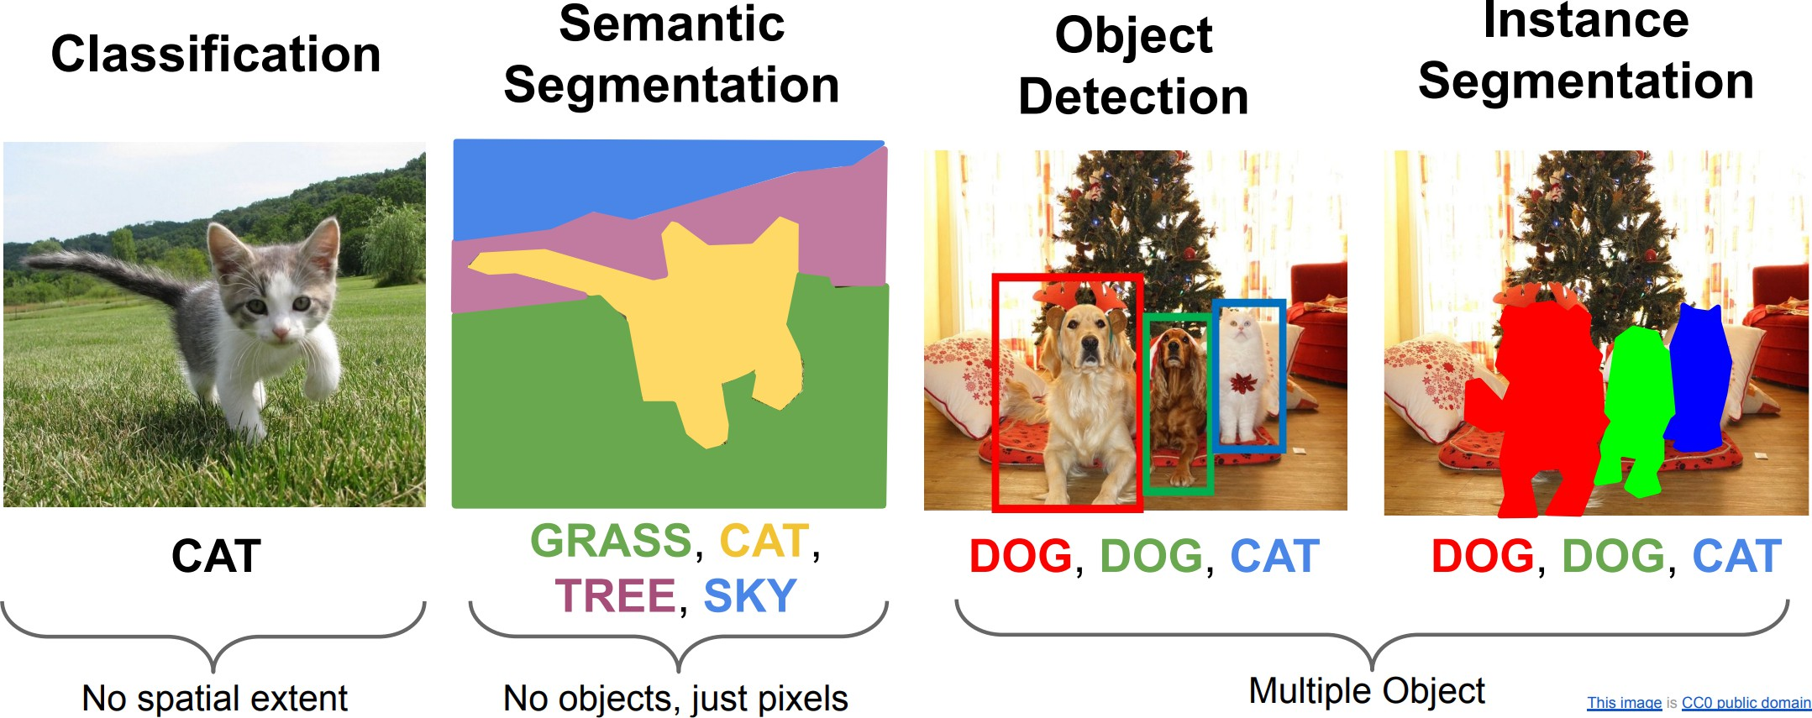
Computer Vision Tasks

Slide 4
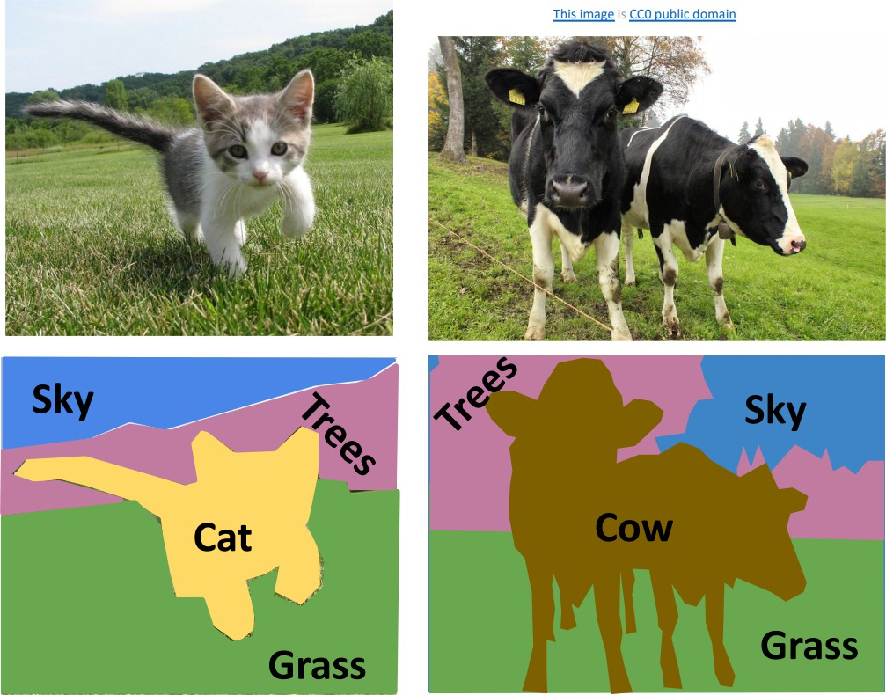
Things and Stuff
▶ Things: Object categories that can be separated into object instances (e.g. cats, cars, person)
▶ Stuff: Object categories that cannot be separated into instances (e.g. sky, grass, water, trees)

Slide 5
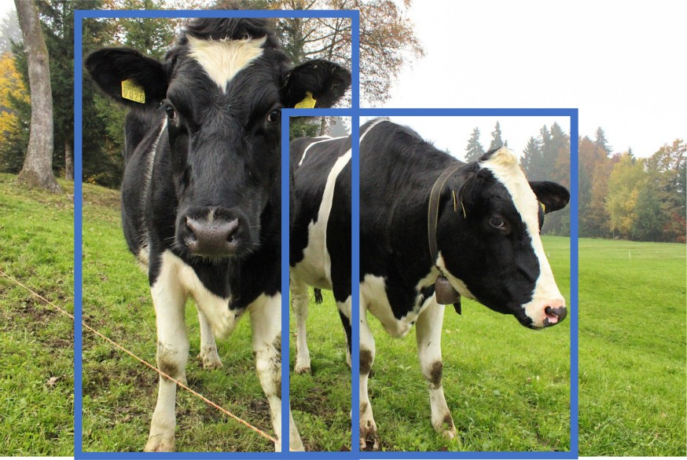
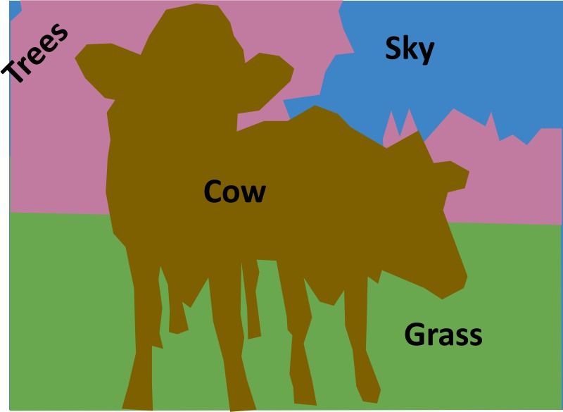
Computer Vision Tasks
▶ Semantic Segmentation: Gives per-pixel labels, but merges instances (Both things and stuff)
▶ Object Detection: Detects individual object instances, but only gives box(Only things!)

Slide 6
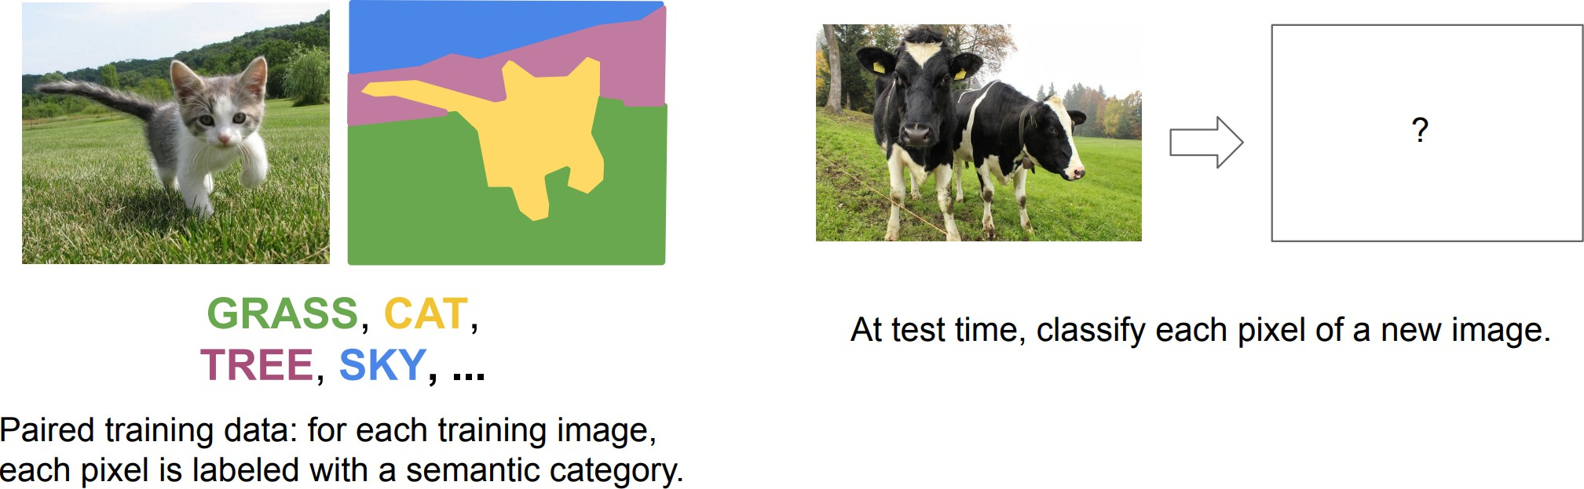
Semantic Segmentation

Slide 7
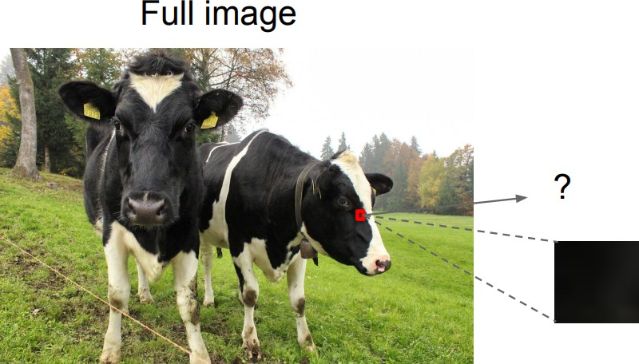
Semantic Segmentation

Slide 8
Semantic Segmentation
▶ Impossible to classify without context
▶ How do we include context?

Slide 9
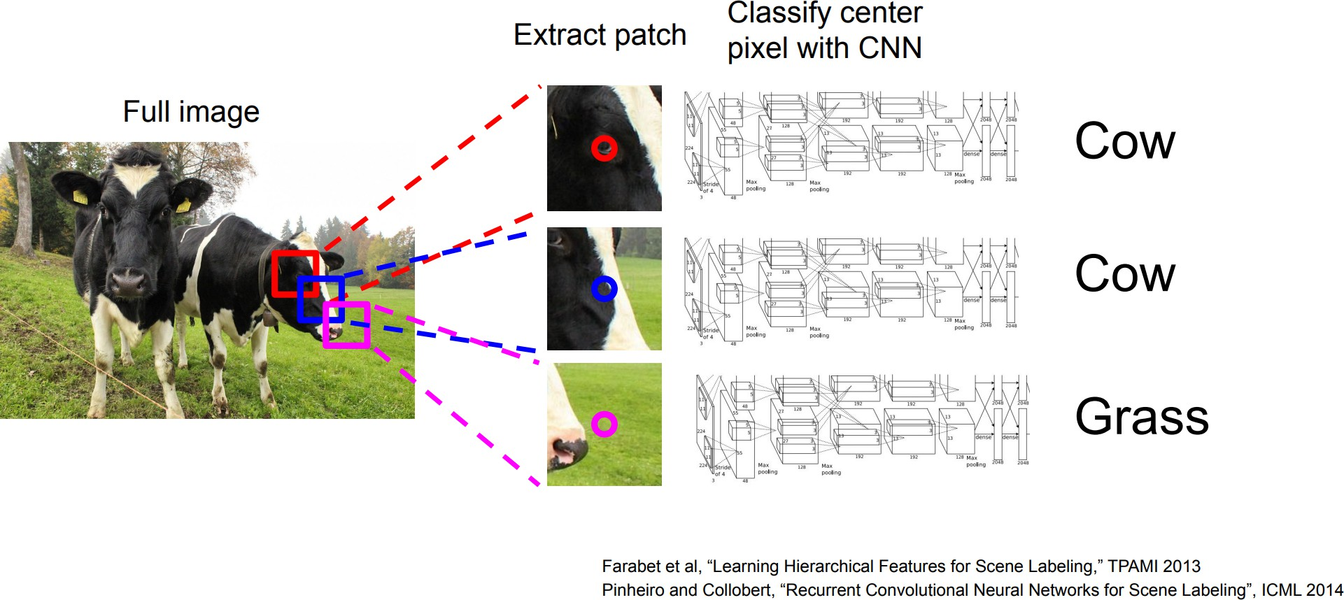
Semantic Segmentation Idea: Sliding Window

Slide 10
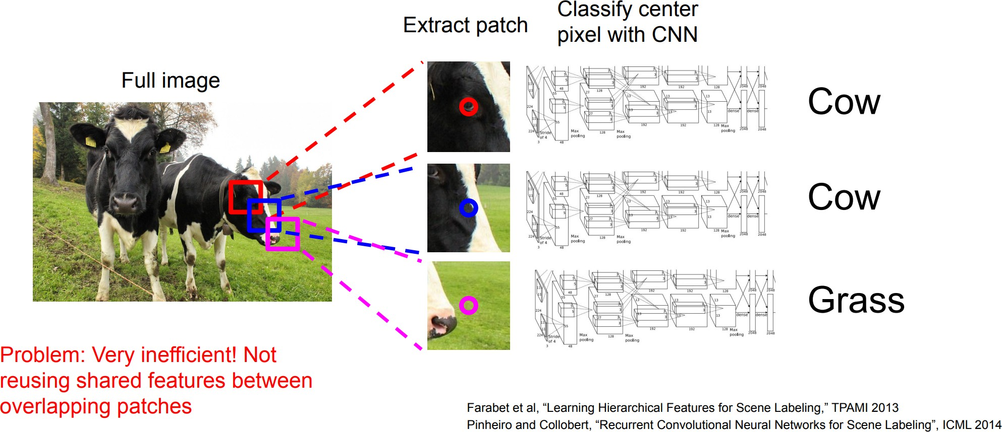
Semantic Segmentation Idea: Sliding Window (cont.)

Slide 11
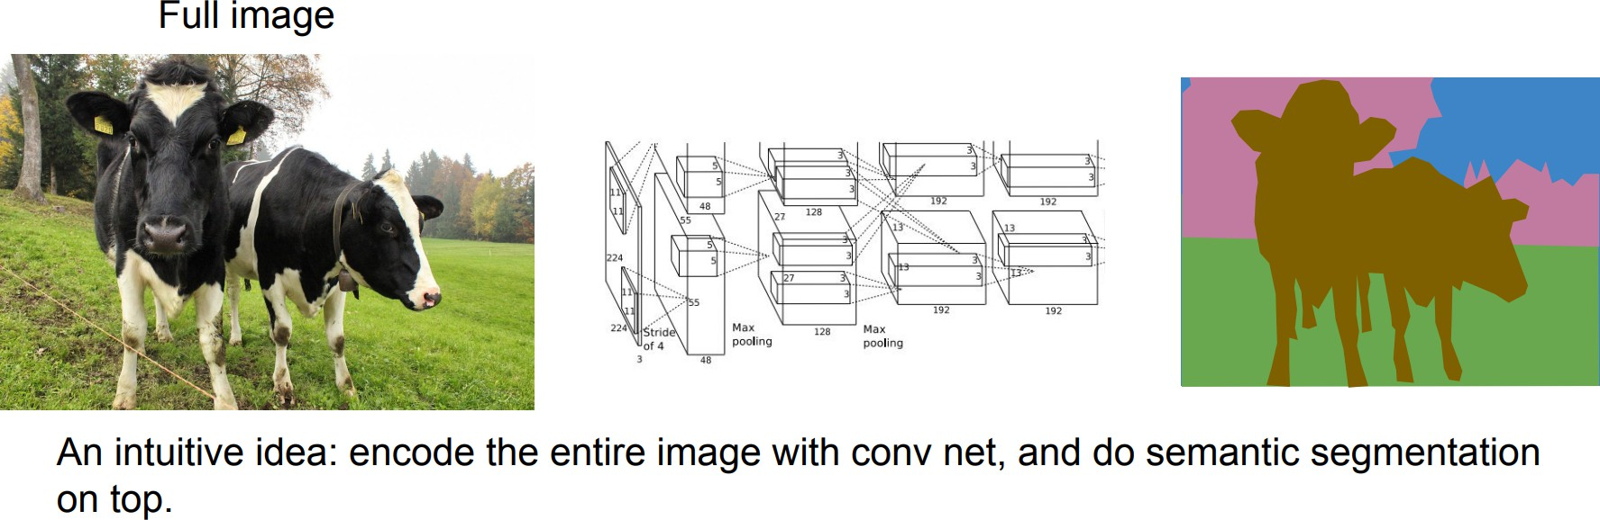
Semantic Segmentation Idea: Convolution

Slide 12
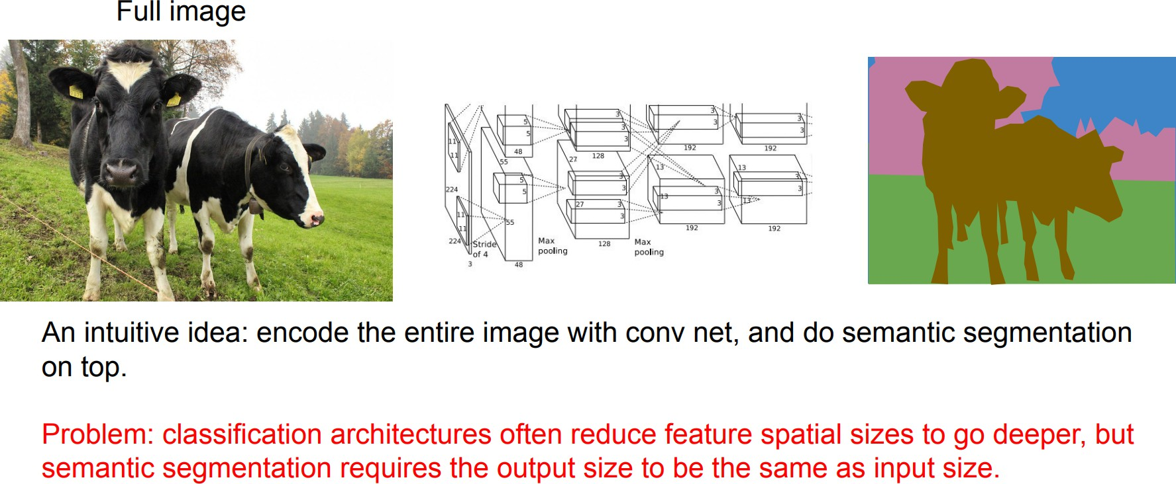
Semantic Segmentation Idea: Convolution (cont.)

Slide 13
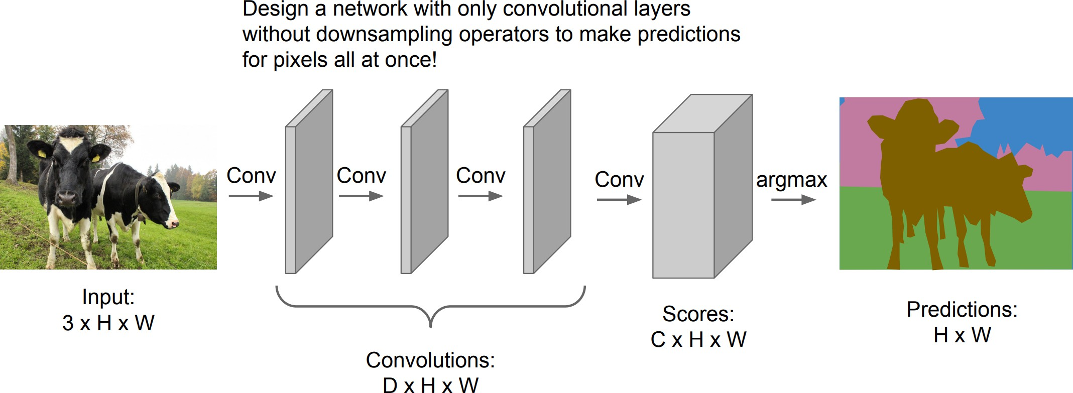
Semantic Segmentation Idea: Fully Convolutional

Slide 14
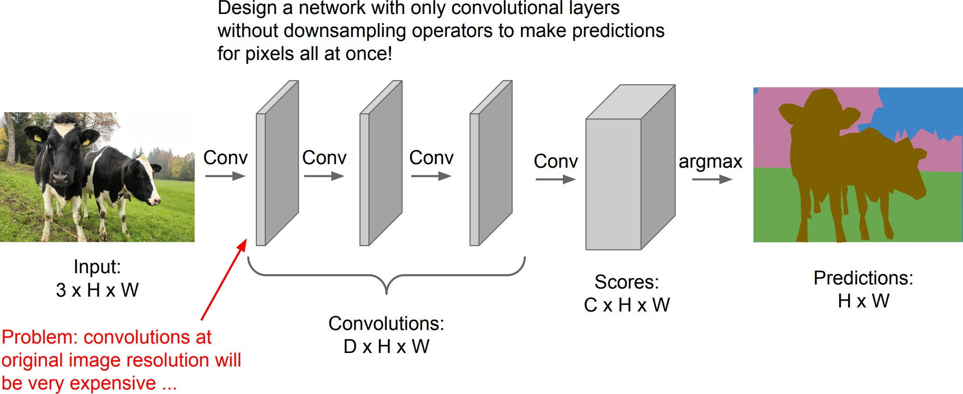
Semantic Segmentation Idea: Fully Convolutional (cont.)

Slide 15
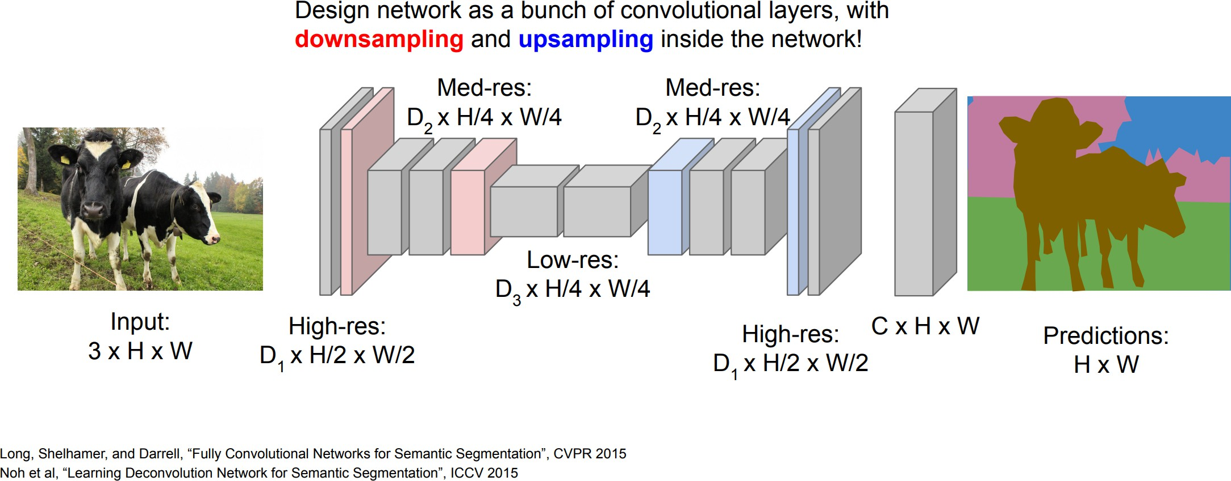
Semantic Segmentation Idea: Fully Convolutional (cont.)

Slide 16
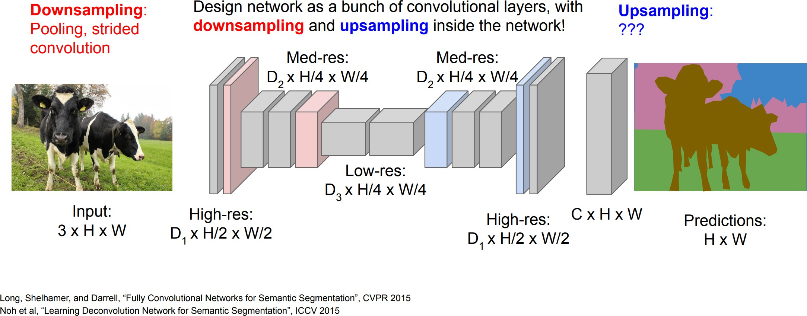
Semantic Segmentation Idea: Fully Convolutional (cont.)

Slide 17
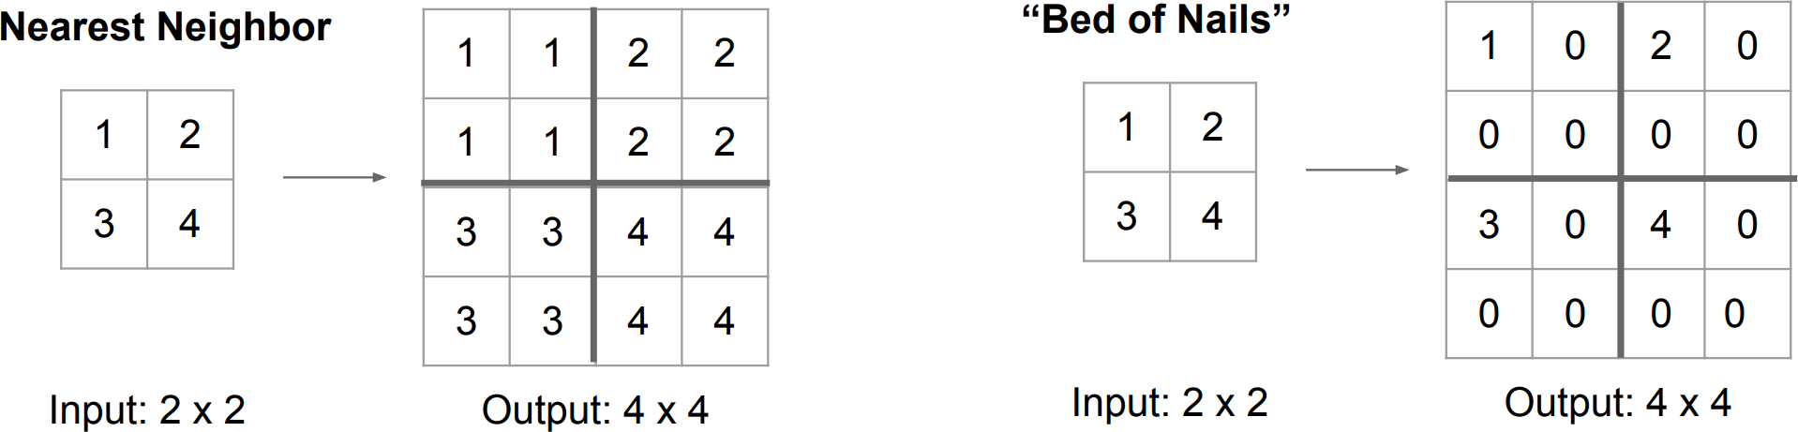
In-Network Upsampling: Unpooling

Slide 18
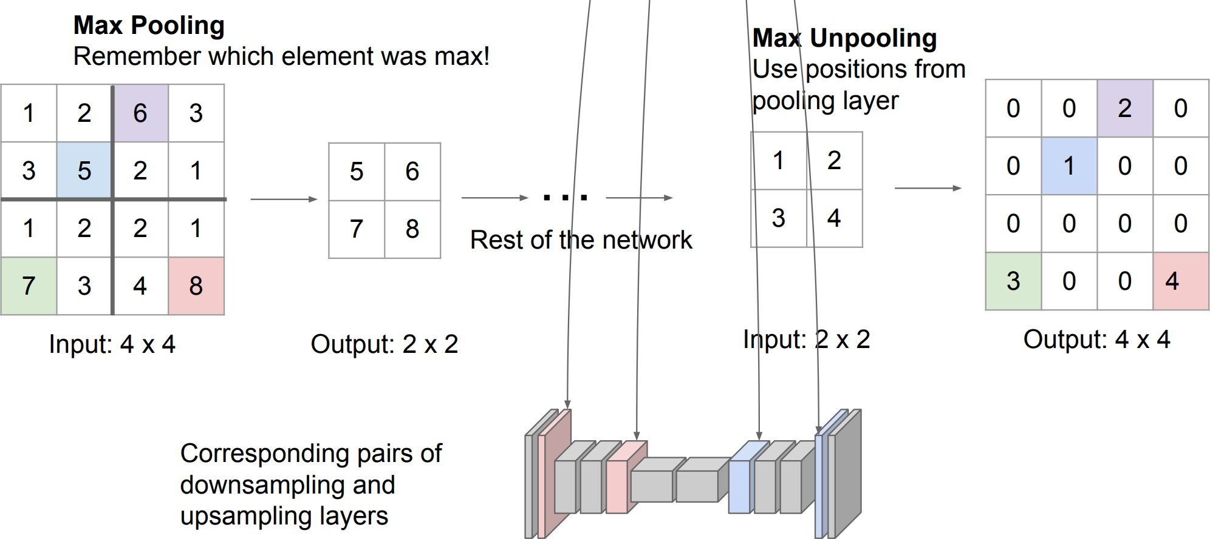
In-Network Upsampling: Max Unpooling

Slide 19
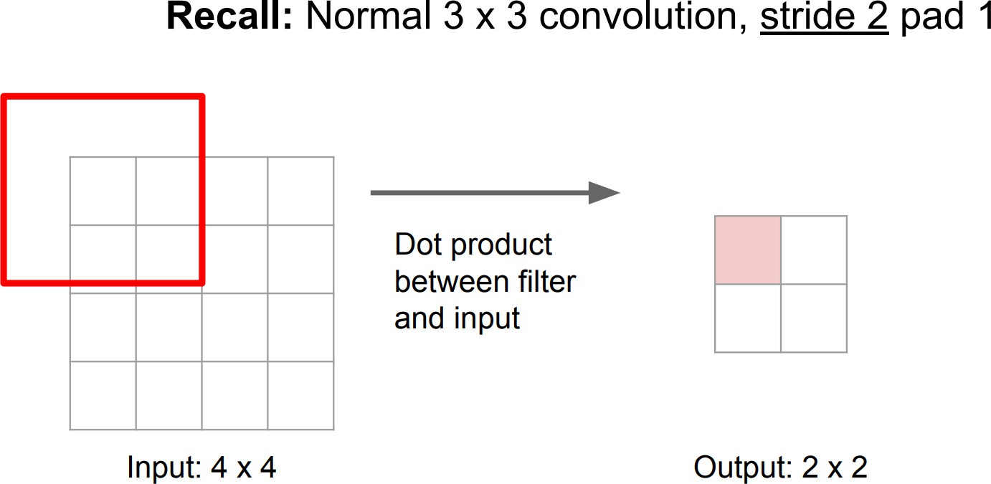
Learnable Upsampling: Transposed Convolution

Slide 20
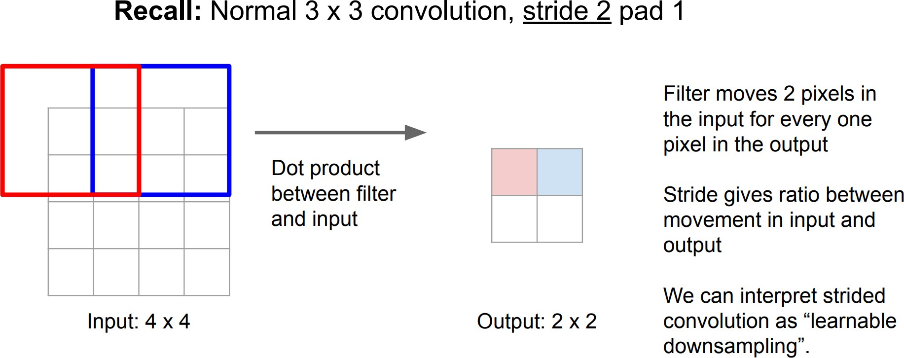
Learnable Upsampling: Transposed Convolution (cont.)

Slide 21
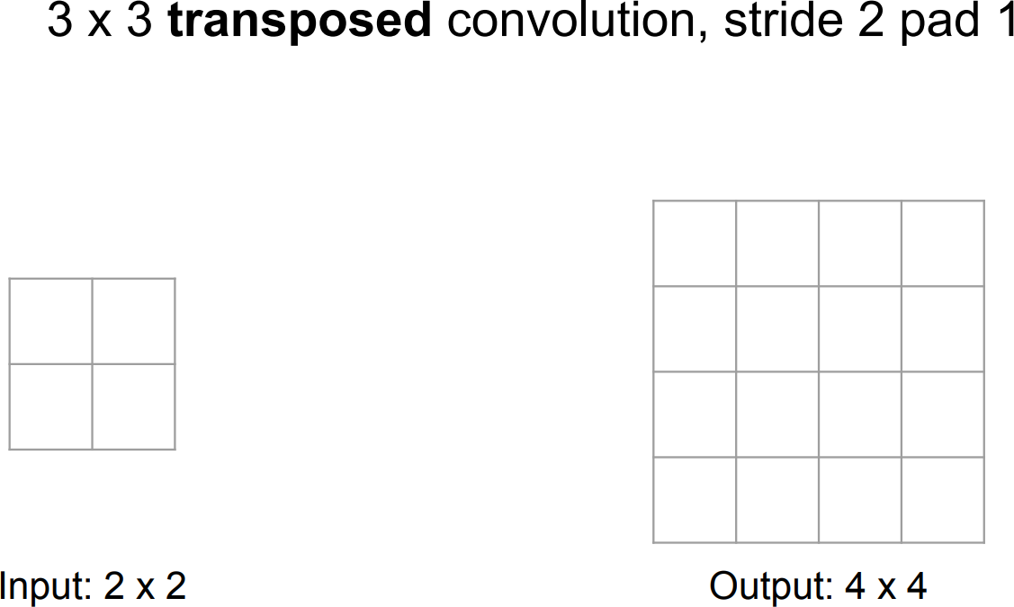
Learnable Upsampling: Transposed Convolution (cont.)

Slide 22
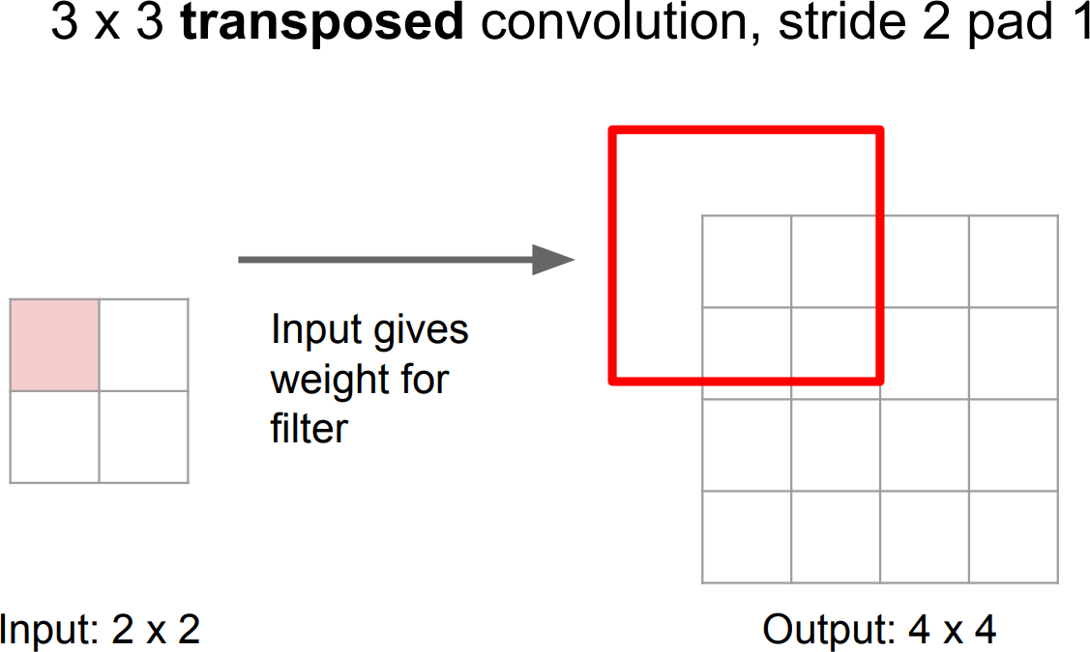
Learnable Upsampling: Transposed Convolution (cont.)

Slide 23
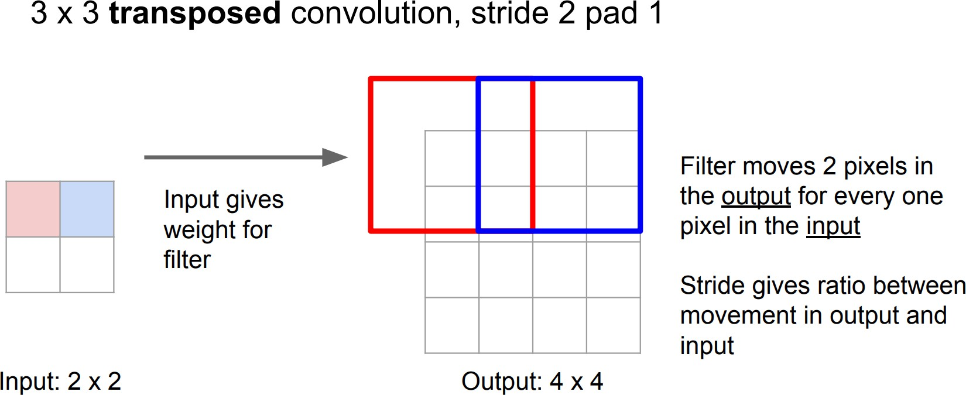
Learnable Upsampling: Transposed Convolution (cont.)

Slide 24
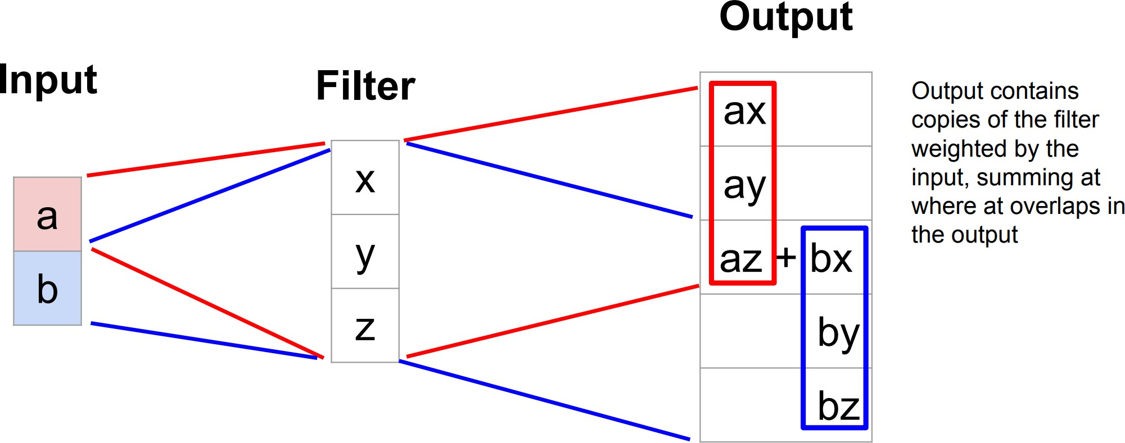
Transposed Convolution: 1D Example

Slide 25
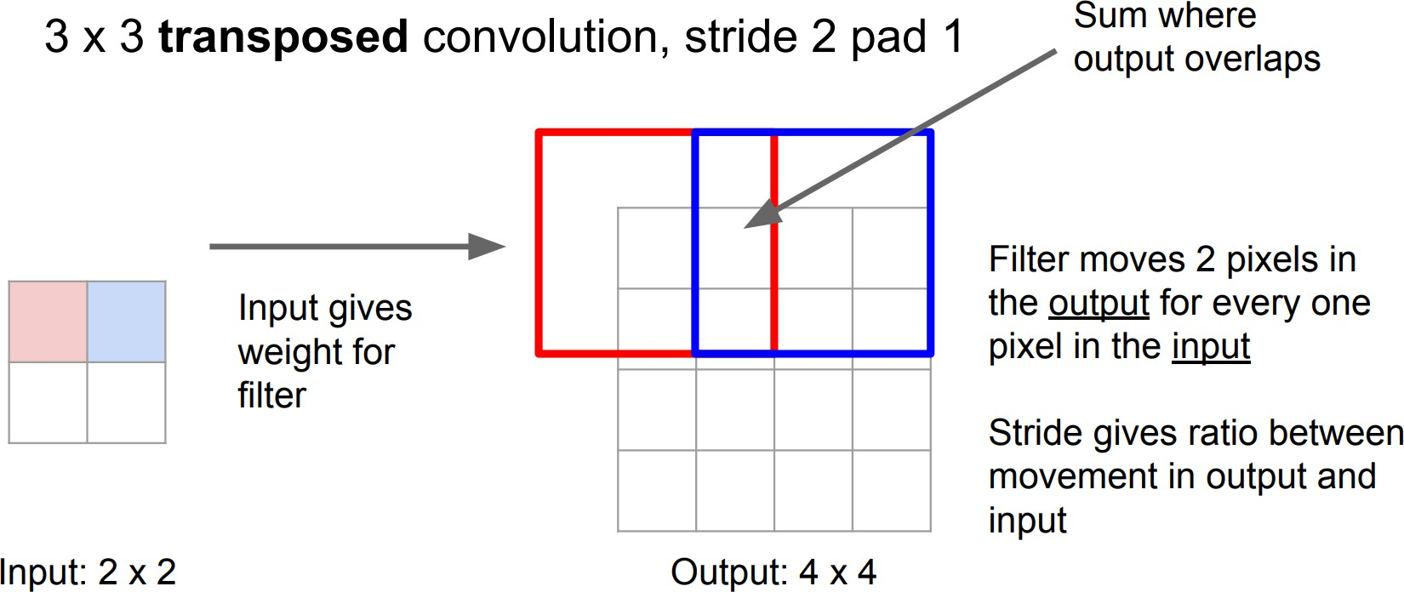
Learnable Upsampling: Transposed Convolution (cont.)

Slide 26
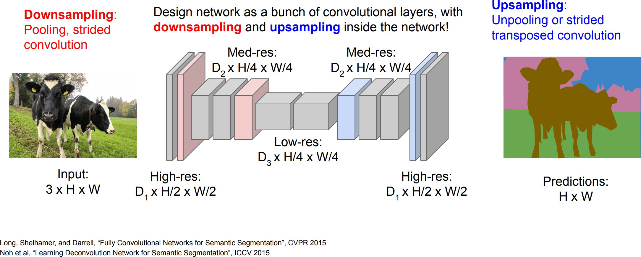
Semantic Segmentation Idea: Fully Convolutional

Slide 27

Semantic Segmentation
▶ Label each pixel in the image with a category label

Slide 28
Semantic Segmentation
▶ Label each pixel in the image with a category label
▶ Does not differentiate instances, only care about pixels

Slide 29
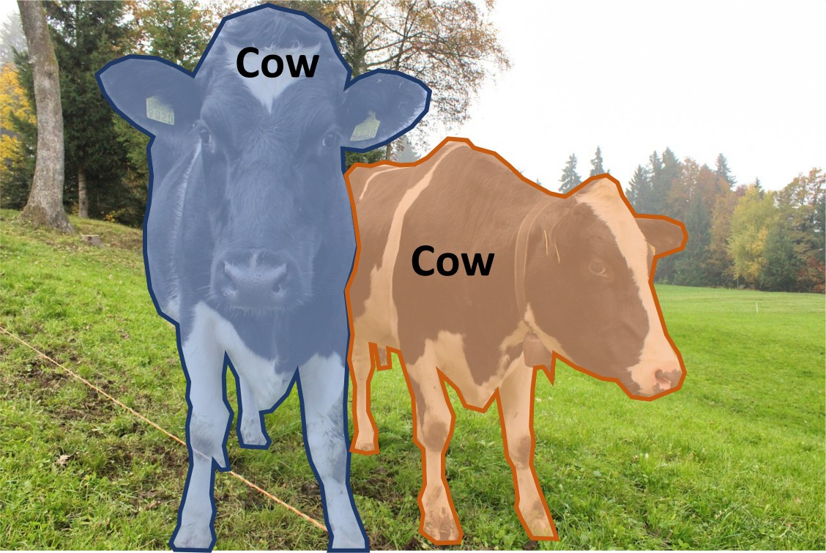
Instance Segmentation
▶ Detect all objects in the image, and identify the pixels that belong to each object (Only things!)

Slide 30
Instance Segmentation
▶ Detect all objects in the image, and identify the pixels that belong to each object (Only things!)
▶ Approach: Perform object detection, then predict a segmentation mask for each object!

Slide 31
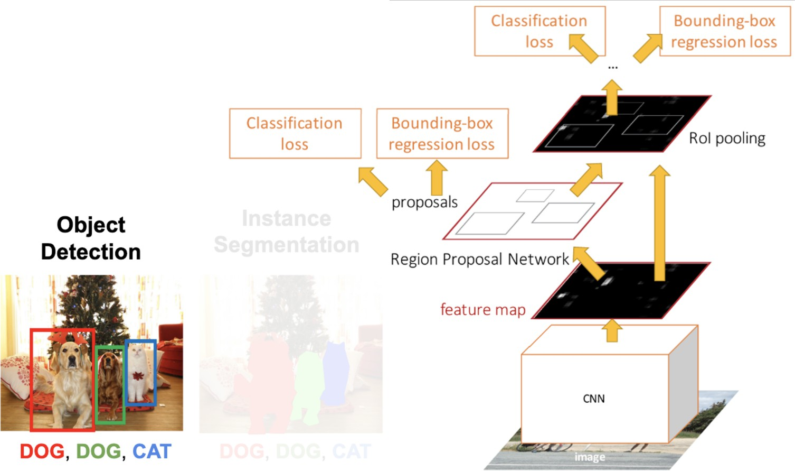
Object Detection: Faster R-CNN

Slide 32
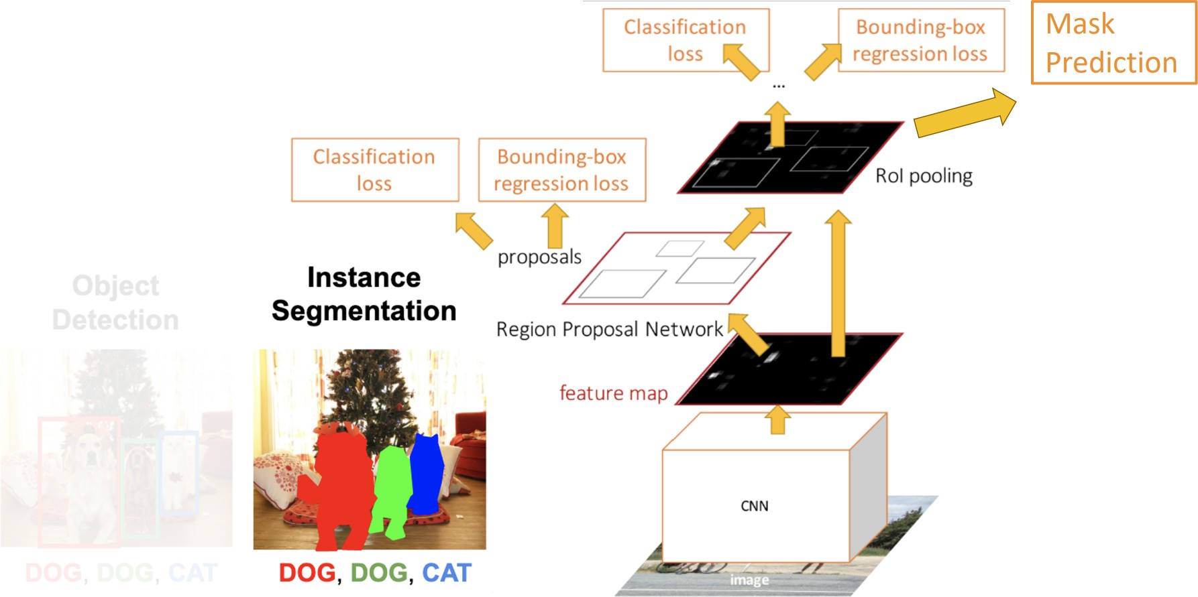
Instance Segmentation: Mask R-CNN
⁰He et al, “Mask R-CNN”, ICCV 2017

Slide 33
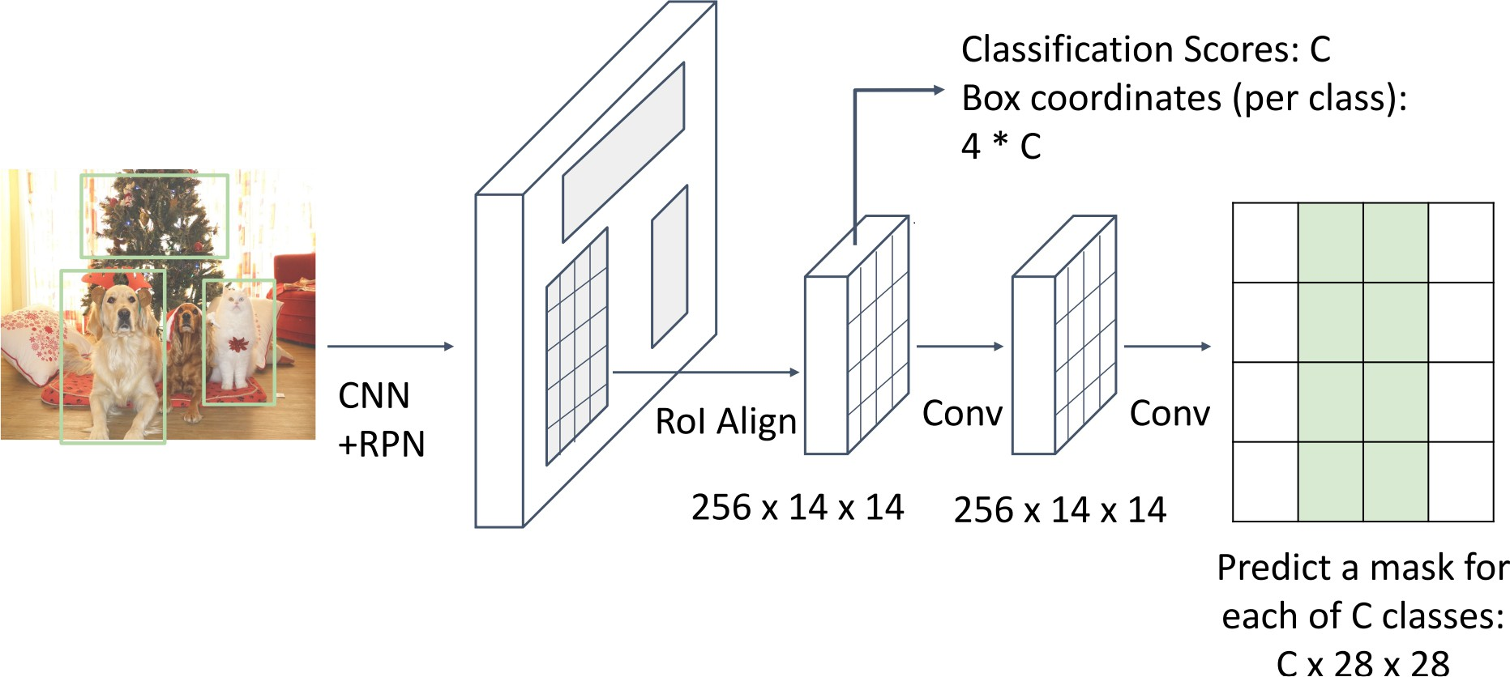
Instance Segmentation: Mask R-CNN

Slide 34
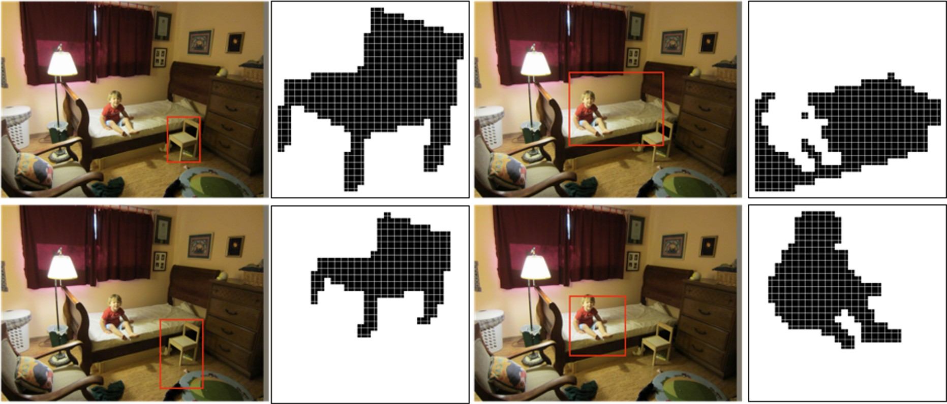
Mask R-CNN: Example Training Targets

Slide 35
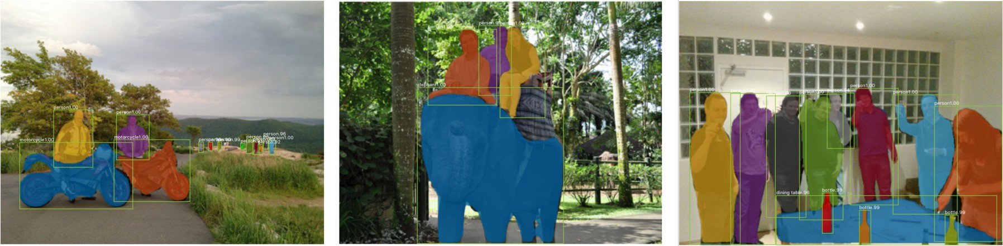
Mask R-CNN: Very Good Results!

Slide 36
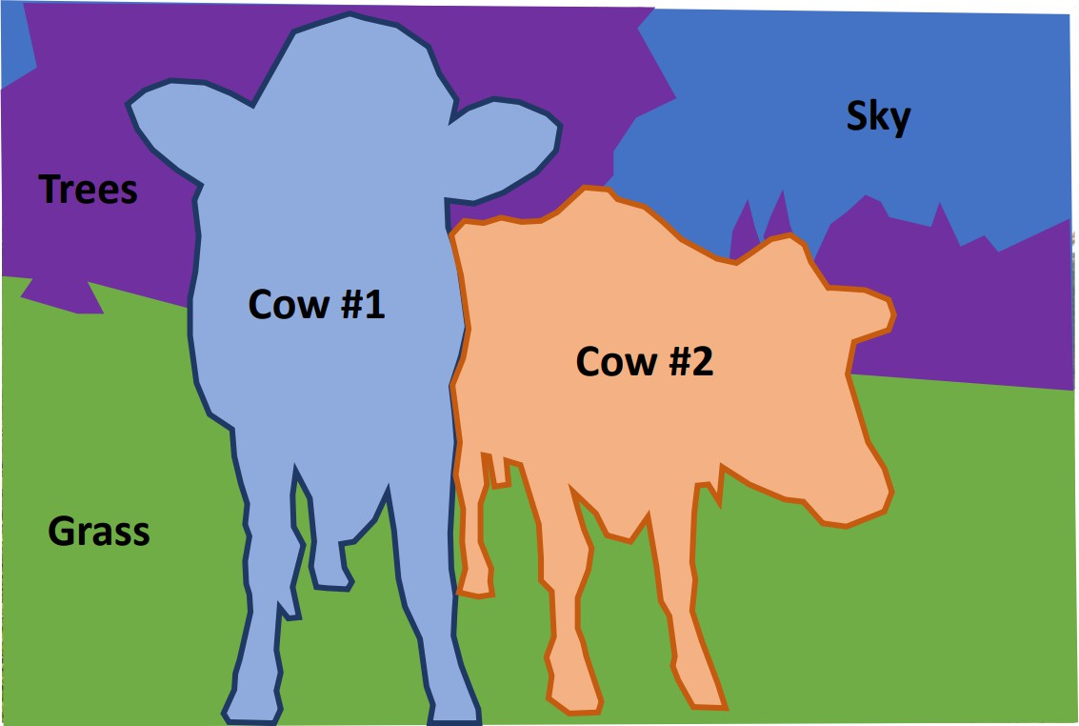
Beyond Instance Segmentation: Panoptic Segmentation
▶ Label all pixels in the image (both things and stuff)
▶ For ”thing” categories also separate into instances

Slide 37
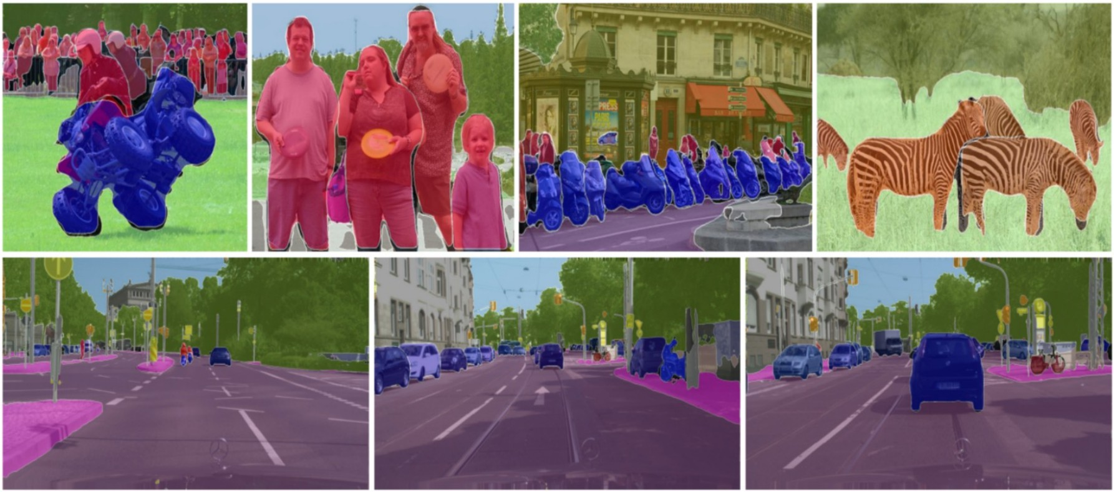
Beyond Instance Segmentation: Panoptic Segmentation
⁰Kirillov et al, “Panoptic Feature Pyramid Networks”, CVPR 2019

Slide 38
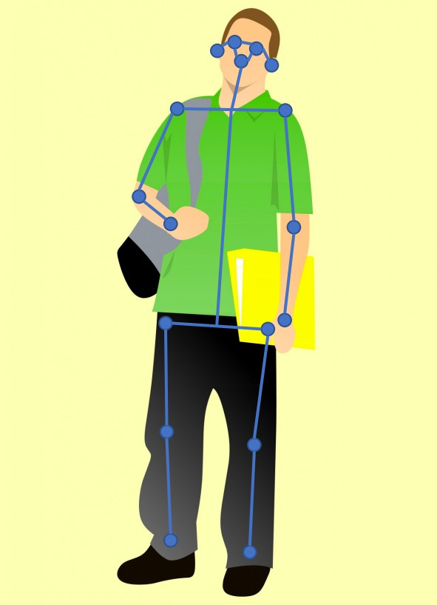
Beyond Instance Segmentation: Human Keypoints
▶ Represent the pose of a human by locating a set of keypoint se.g. 17 keypoints:
▶ Nose
▶ Left / Right eye
▶ Left / Right earLeft / Right shoulder
▶ Left / Right elbow
▶ Left / Right wrist

Slide 39
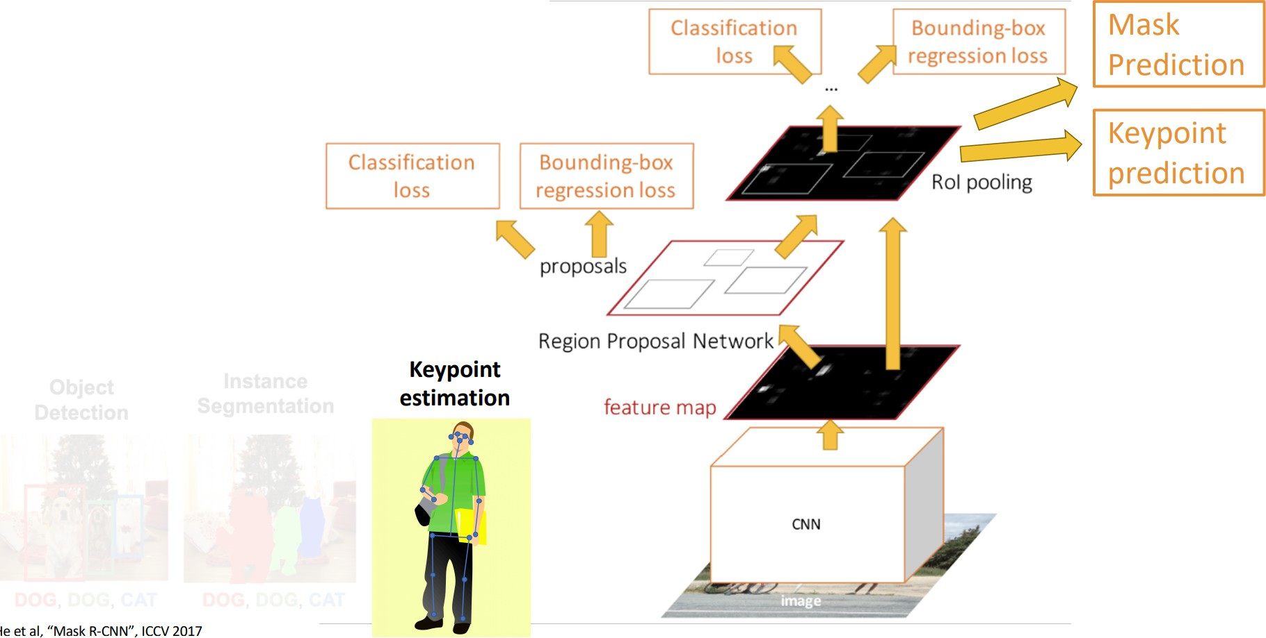
Mask R-CNN: Keypoint Estimation

Slide 40
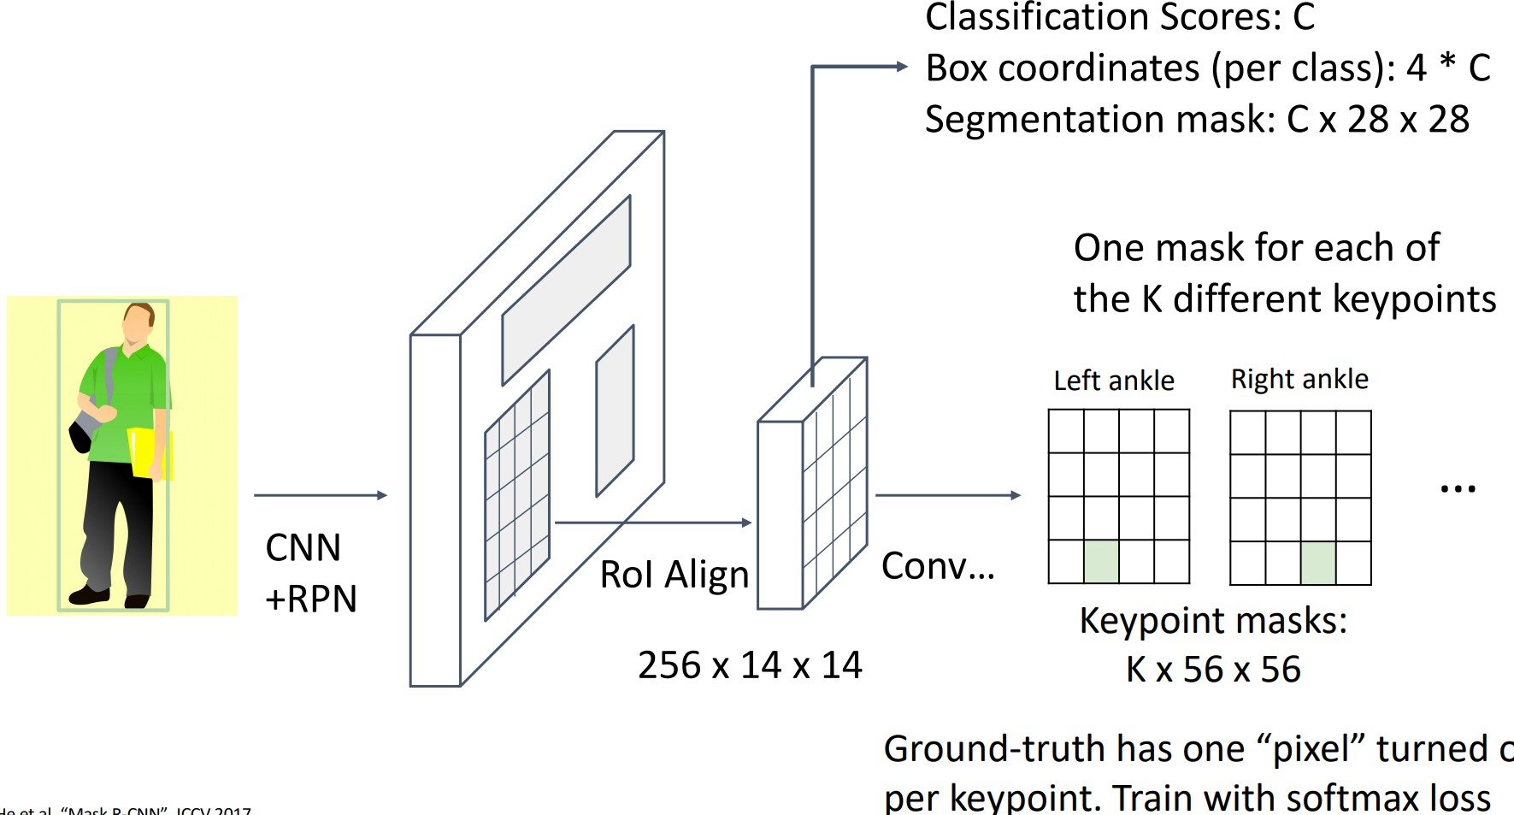
Mask R-CNN: Keypoint Estimation

Slide 41
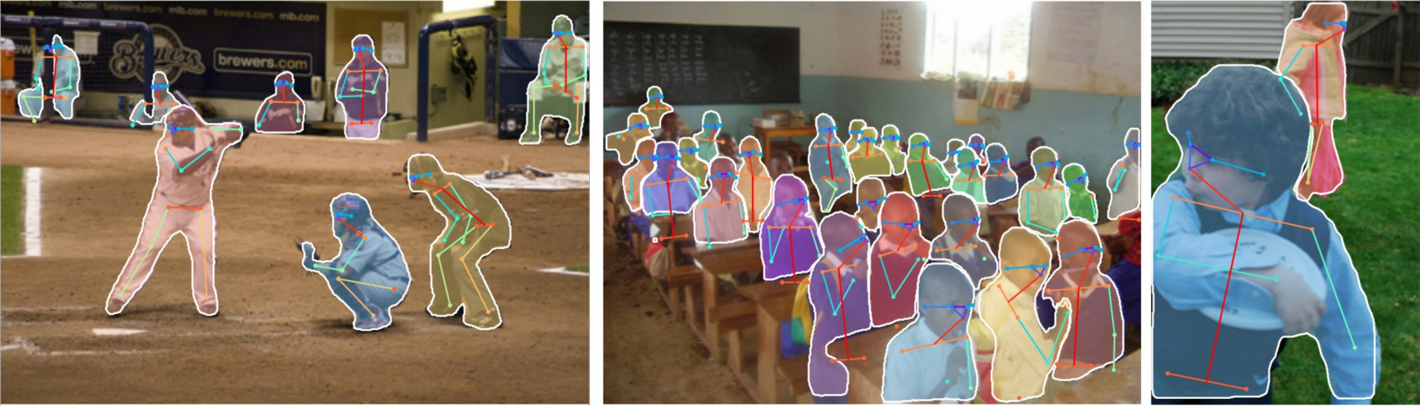
Joint Instance Segmentation and Pose Estimation
⁰He et al, “Mask R-CNN”, ICCV 2017

Slide 42
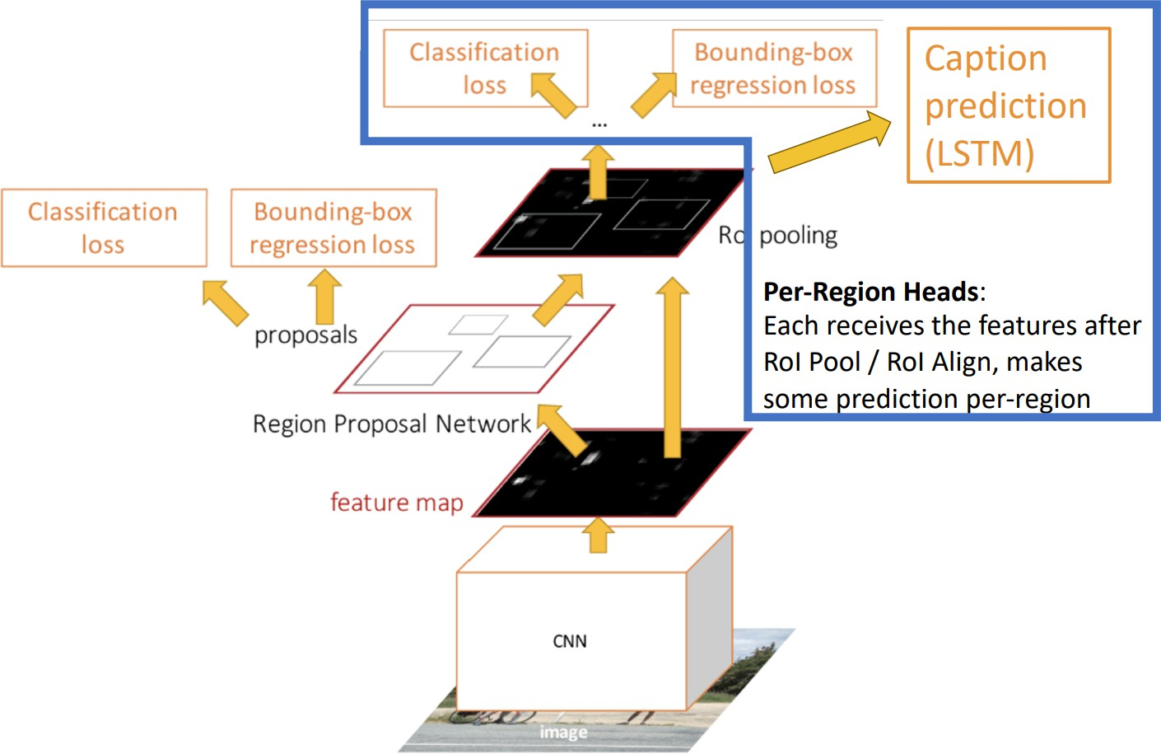
Captioning: Predict a caption per region!

Slide 43
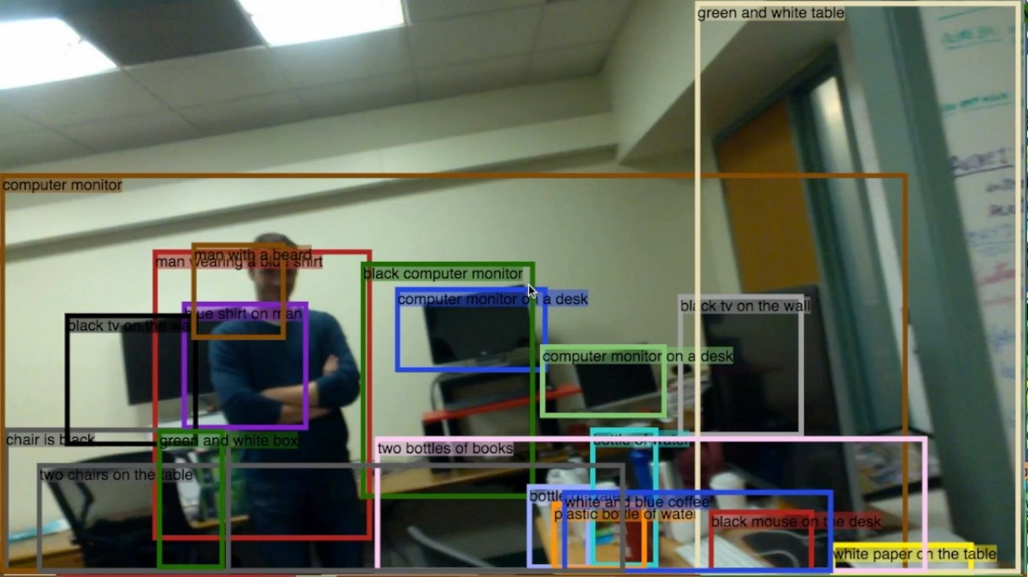
Captioning: Predict a caption per region!
Johnson, Karpathy, and Fei-Fei, ”DenseCap: Fully Convolutional Localization Networks for Dense Captioning”, CVPR 2016

Slide 44
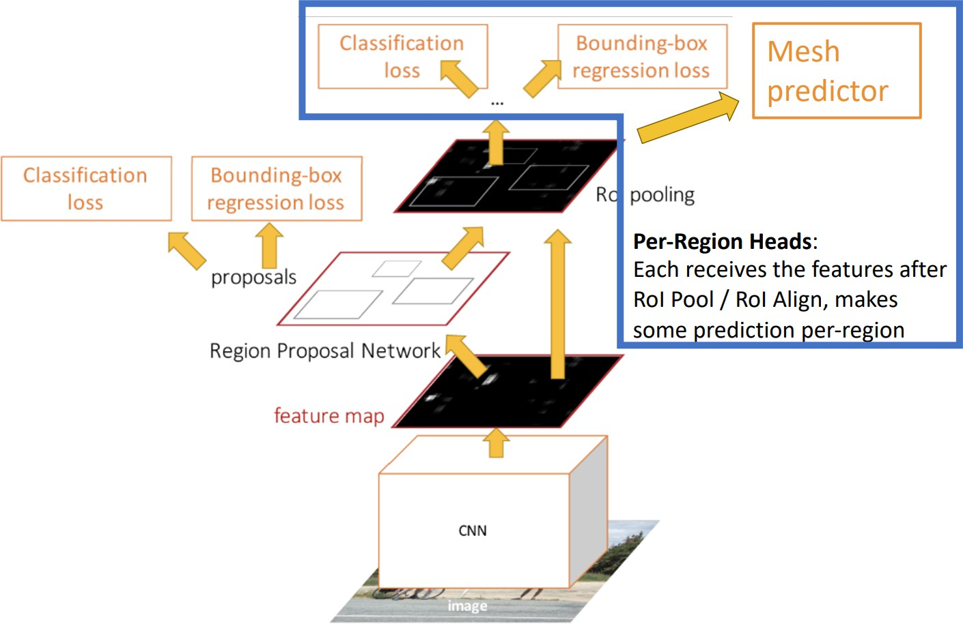
3D Shape Prediction

Slide 45
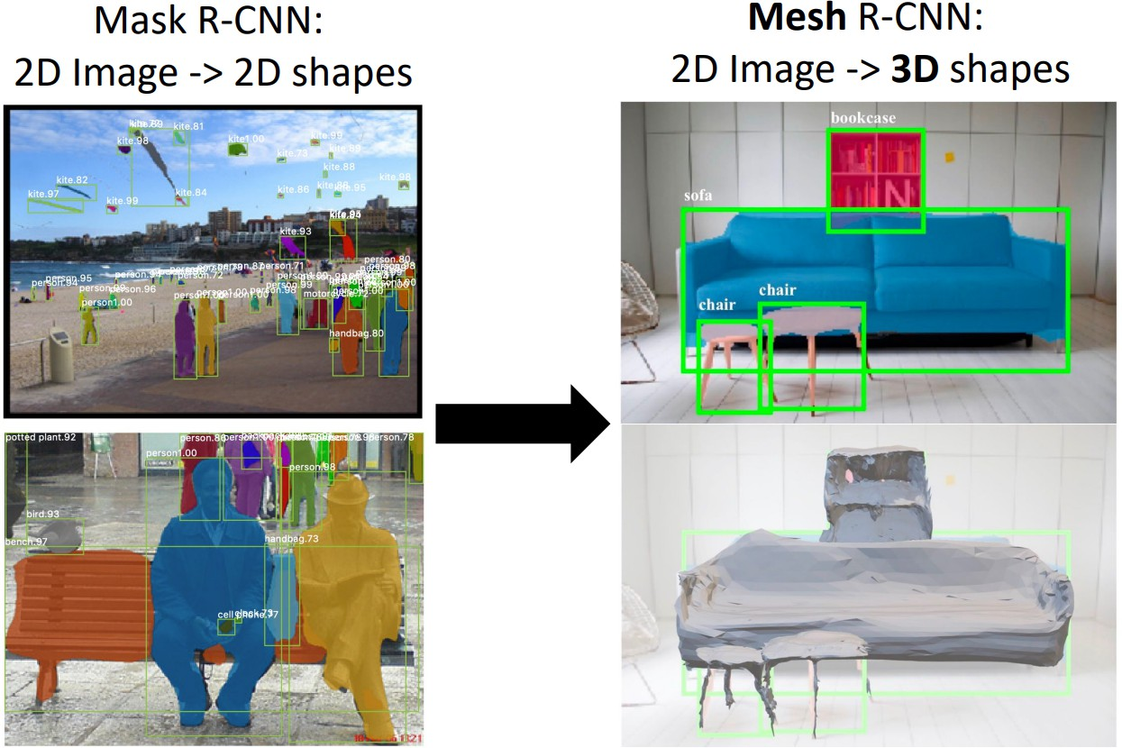
3D Shape Prediction
Gkioxari, Malik, and Johnson, ”Mesh R-CNN”, ICCV 2019

Slide 46
Object Tracking
▶ Goal: Track objects over a sequence of photos or a video
▶ Exceedingly challenging in multi-object tracking scenarios
▶ Need to take care of not mixing up or losing objects midway
▶ One Solution: Perform object detection and assign IDs to each object and store its feature vector. Then track the objects based on its ID and feature vector

Slide 47
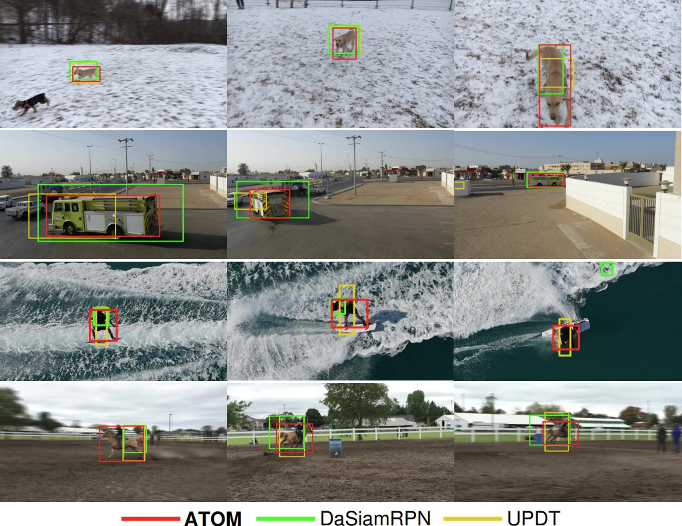
Object Tracking
Figure 2: Comparison of 3 approaches for object tracking
Danelljan et al.

Slide 48

References
These slides have been adapted from
▶ Fei-Fei Li, Yunzhu Li & Ruohan Gao, Stanford CS231n: Deep Learning for Computer Vision
▶ Assaf Shocher, Shai Bagon, Meirav Galun & Tali Dekel, WAIC DL4CV Deep Learning for Computer Vision: Fundamentals and Applications
▶ Justin Johnson, UMich EECS 498.008/598.008: Deep Learning for Computer Vision

